Slide 1
Spelling Bee

Slide 2
Spelling Bee

Slide 3
You will need to have the sound on and turned up for this game.
Click play on the audio recordings to hear the word you are to spell. The audio will say a word and then repeat that word in a sentence.
Once you have completed spelling the word, click on the PowerPoint to reveal the answer. You can write on a piece of paper or spell it aloud.
See if you spelled the word correctly!
The presentation begins with very easy words and progresses into some harder, more commonly misspelled words.
Have fun!

Slide 4
BAKE

Slide 5
FRIED

Slide 6
RIP

Slide 7
SEA

Slide 8
CHASE

Slide 9
BUMBLE BEE

Slide 10
COUNTING

Slide 11
TENTH

Slide 12
STRETCH

Slide 13
HAPPEN

Slide 14
Medium-level spelling words

Slide 15
FEVER

Slide 16
EVENING

Slide 17
LIBRARIES

Slide 18
PIONEER

Slide 19
LAUGHTER

Slide 20
INVENTOR

Slide 21
MESSAGE

Slide 22
ESPECIALLY

Slide 23
VACUUM

Slide 24
PERSUADE

Slide 25
Harder-level spelling words

Slide 26
AUTHORITY

Slide 27
CONSEQUENTLY

Slide 28
PHANTOM

Slide 29
ADVANTAGEOUS

Slide 30
PARALLEL

Slide 31
CELERY

Slide 32
SOUVENIR

Slide 33
QUESTIONNAIRE

Slide 34
DEFICIENCY

Slide 35
RECTANGULAR

Slide 36
MALADY

Slide 37
OMINOUS

Slide 38
UBIQUITOUS

Slide 39
VIVACIOUS

Slide 40
POTPOURRI

Slide 41
HANDKERCHIEF

Slide 42
PRONUNCIATION

Slide 43
PHARAOH

Slide 44
Difficult-level spelling words

Slide 45
EUDAEMONIC

Slide 46
ODONTALGIA

Slide 47
LOGORRHEA

Slide 48
PROSPICIENCE

Slide 49
CYMOTRICHOUS

Slide 50
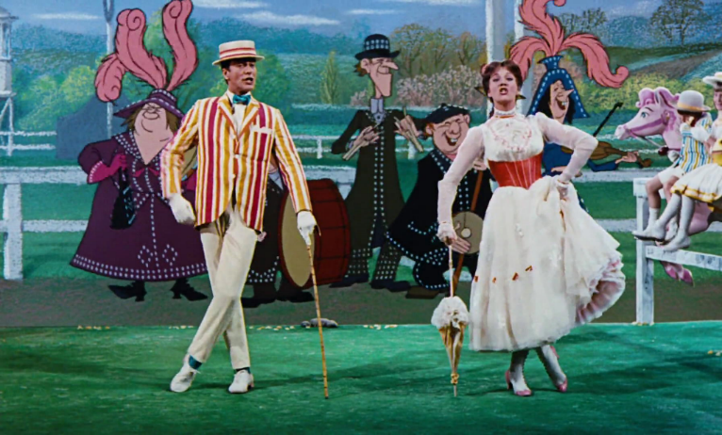
Bonus Word
SUPERCALIFRAGILISTICEXPIALIDOCIOUS

Slide 51
Find Us on the Web
For more information, resources and helpful videos visit the McCormick Care Group “Caregiver’s Corner” website
Like us on Facebook “McCormick Dementia Services”
Subscribe to our YouTube channel “McCormick Care Group”

